Slide 1

ALY 6010 Probability Theory and Introductory Statistics Final Project Presentation European Football Wages Analysis
Muhammad Umer Mirza
mirza.mu@northeastern.edu

Slide 2
Introduction
Dataset sourced from Kaggle, featuring 2022 wages of nearly 3,900 players across six European leagues.
Data extracted from Football Manager 2022, a widely utilized simulation tool among football fans and professionals.
Project Overview:
Commenced with exploratory data analysis to detect underlying patterns.
Advanced to hypothesis testing to deduce the determinants of player wages.
Focus of Report:
Analyzing the interplay between a player’s wage and their league affiliation, playing position, and frequency of club and international appearances.

Slide 3
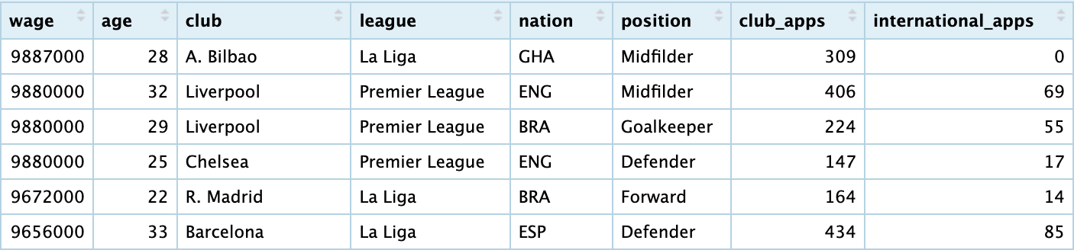
Data Cleaning
Began with 3,907 data entries covering comprehensive player details.
Enhanced R compatibility: Renamed columns for better clarity and analysis.
Formatted wage figures for accuracy, setting 'league' and 'position' as categories.
Identified and removed outliers: Excluded wages above the $10 million threshold.
Resulted in a polished dataset with 3,841 entries and 8 columns ready for in-depth analysis.

Slide 4
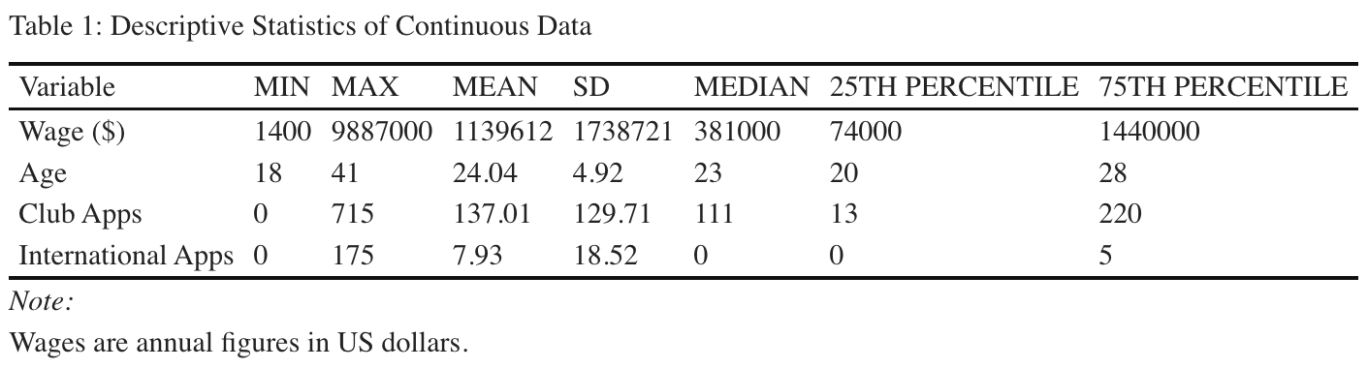
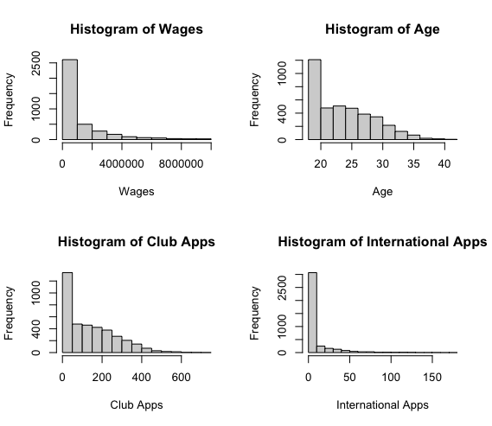
Insights from Exploratory Data Analysis
Median wage of $381,000; average wage at $1,139,612, indicating skewed distribution.
Player ages center around 23 years, with club appearances typically under 220.
International appearances rarer, median at 0 with 75% having ≤ 5 caps.
Premier League and Primiera Liga most represented; defenders & midfielders dominant.
Data suggests younger player cohort, with financial disparities evident in wages.
Central Limit Theorem:Dataset’s size enables parametric testing under central limit theorem, despite skew.

Slide 5
Data Analysis and Research Questions
Focus on Premier League, Primiera Liga, and positions: Defenders & Midfielders.
Hypothesis tests to assess impact of league and position on wages.
Regression analysis to determine the effect of age, club, and international appearances on wages.
Research Goals:
To determine if categorical distinctions (league & position) significantly affect wages.
To explore predictive factors for wages: Age, club appearances, and international caps.
Methodology:
Applied hypothesis testing and regression analysis for deeper insights.

Slide 6
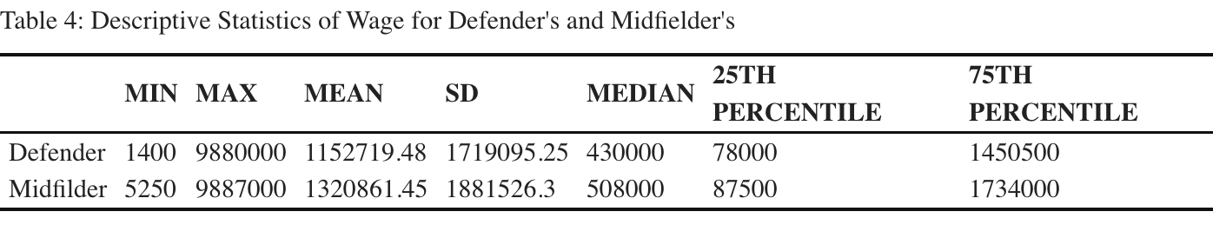
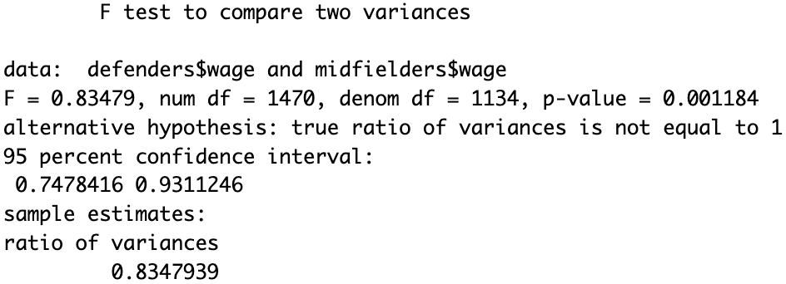
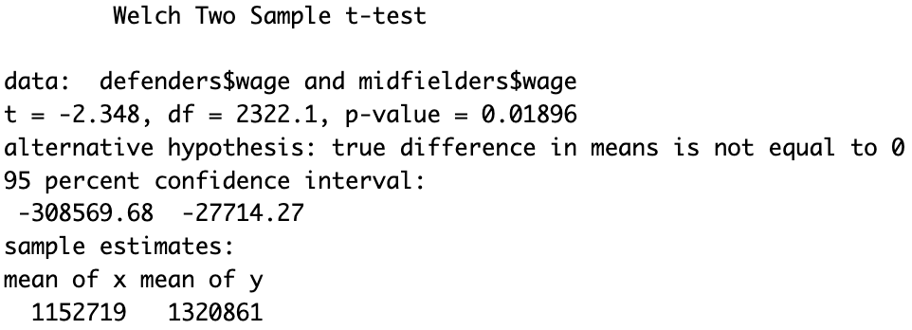
Comparing Wages: Defenders vs. Midfielders
At a 0.05 alpha, is there a statistically significant difference in average wages between defenders and midfielders?
Method:
Independent two-tailed t-test (F-test indicated unequal variances).
H0: μ_defenders = μ_midfielders.
H1: μ_defenders ≠ μ_midfielders.
Results:
Point estimate of wage difference: $168,142 (midfielders earn more).
T-test results:
t-value = -2.348, p-value = 0.01896.
95% Confidence Interval:
Approximately -$308,570 to -$27,714.
Conclusion:
Significant wage disparity between positions.
Reject H0; Wage difference not due to random variation.

Slide 7
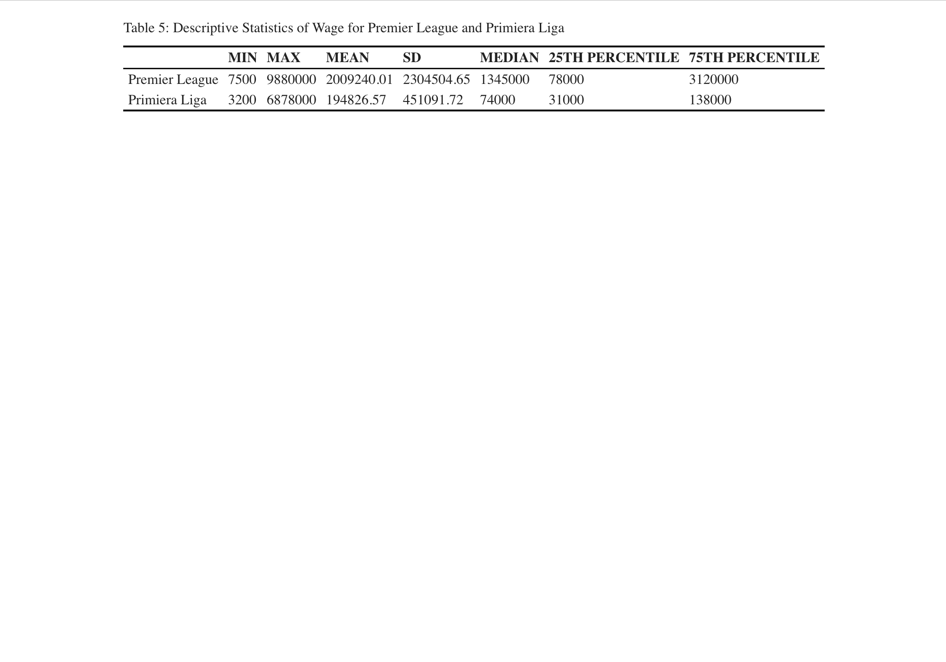
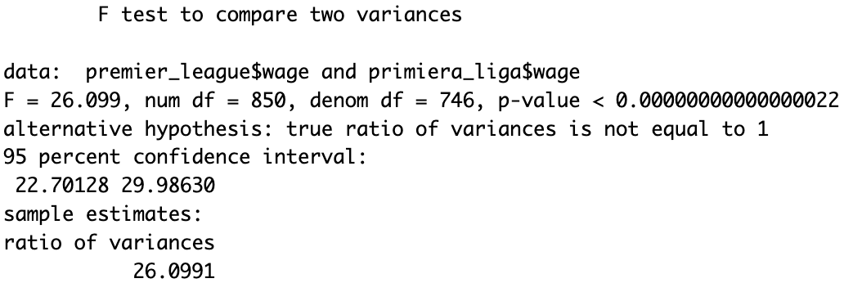
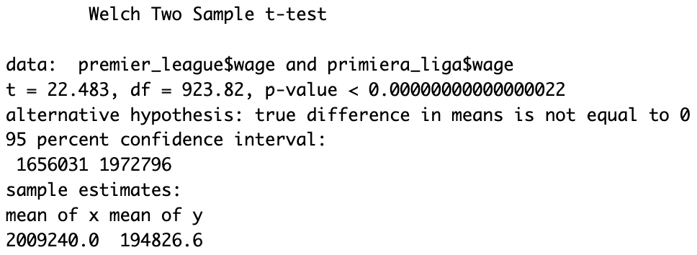
Wage Comparison: Premier League vs. Primiera Liga
At a 0.05 alpha, is there a statistically significant difference in average wages between the Premier League and Primiera Liga?
Method:
Independent two-tailed Welch's t-test (due to unequal variances as per F-test).
H0: μ_premier_league = μ_primiera_liga
H1: μ_premier_league ≠ μ_primiera_liga
Results:
Point estimate of wage difference: Approximately $1,814,414 (Premier League higher.
T-test results:
t-value = 22.483, p-value < 0.05
95% Confidence Interval:
$1,656,031 to $1,972,796.
Conclusion:
Significant wage difference between leagues.
Reject H0; Substantial economic contrast within European football.

Slide 8
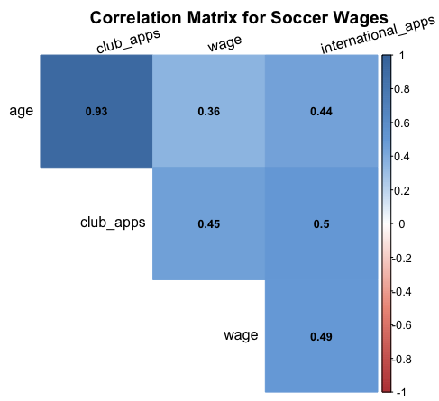
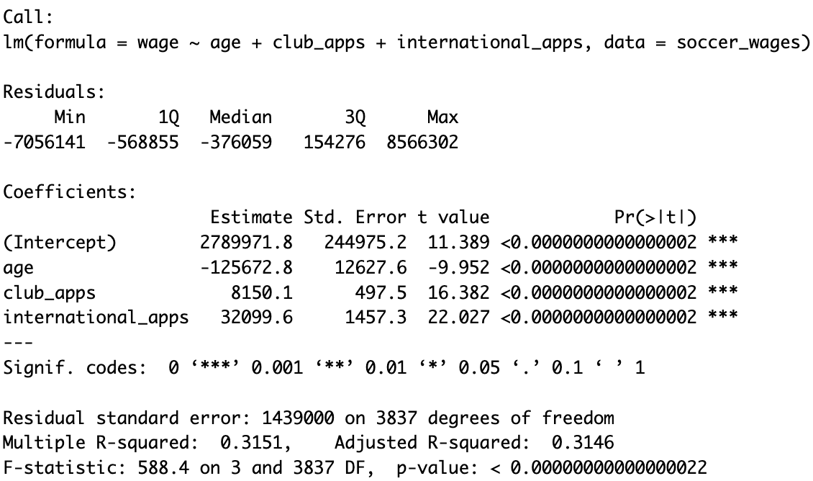
Predictive Analysis: Impact of Age, Club, and International Appearances on Wages
Examine how age, club, and international appearances predict wages.
Model:
Wage = 2789971.8 - 125672.8*(age) + 8150.1*(club_apps) + 32099.6*(international_apps).
Key Findings:
Age negatively impacts wages, while both club and international appearances increase wages.
Statistical Significance:
All variables significantly predict wages (p-values < 0.05).
Insights:
Each additional year of age decreases wage by approx. $125,673.
Each club appearance adds around $8,150, and each international cap adds about $32,100.
Caution:
Model limitations: Significant unexplained variance in wages.
Weak R-squared value (0.3151) implies caution in interpretation.
Conclusion:
Experience is valuable, but other factors outside the model also influence wages.

Slide 9
Summary
Premier League and Primiera Liga, along with defenders and midfielders, were most represented in the dataset.
Hypothesis tests showed significant wage differences by league (Premier League vs. Primiera Liga) and position (defenders vs. midfielders).
Regression analysis indicated age, club, and international appearances significantly predict wages, though with some limitations in the model.
Findings highlight the roles of league, position, and experience in determining footballers' wages, useful for career and contract insights.

Slide 10
References
Bluman, A. (2018). Elementary statistics: A step by step approach (10th ed.). McGraw Hill.ISBN 13: 978-1-259-755330.
Habbous, S. (2023). Module 1-6. Canvas. https://northeastern.instructure.com/courses/160615/modules
Yash. (2023). Football Wages Dataset. Www.kaggle.com. https://www.kaggle.com/datasets/ultimus/football-wages-prediction/data
Yaldo, L., & Shamir, L. (2017). Computational Estimation of Football Player Wages. International Journal of Computer Science in Sport, 16(1), 18–38. https://doi.org/10.1515/ijcss-2017-0002
Paetzold, Ramona. (2016). Re: Low R-squared values in multiple regression analysis?. https://www.researchgate.net/post/Low-R-squared-values-in-multiple-regression-analysis/56f40be793553b1f9a11fcb3/citation/download.
Frost, J. (2019, June 13). How to Interpret Regression Models that have Significant Variables but a Low R-squared - Statistics By Jim. Statistics by Jim. https://statisticsbyjim.com/regression/low-r-squared-regression/
Valchanov, I. (2018, November 7). Point Estimate and Confidence Interval. 365 Data Science. https://365datascience.com/tutorials/statistics-tutorials/point-estimates-confidence-intervals/

Slide 11
Thank You!

